Slide 1
0x203 – Integrity
ECED4406 – Computer Security
Dr. Colin O’Flynn
Dalhousie University.

Slide 2
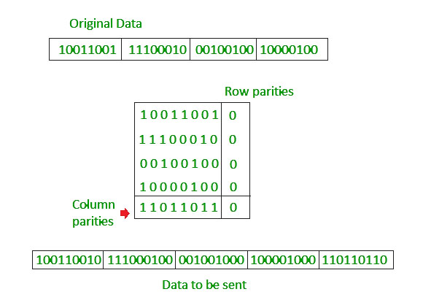
Integrity
Data protected by unauthorized modifications.
WARNING: There is a difference between integrity in communications / electronics context & integrity in security / cryptography context!
Common checksums, CRCs, parity checks, etc often use reversable algorithms, or very short lengths.
An attacker may be able to modify the file in such a way the same checksum is generated.
Thus a checksum, CRC, and other common techniques are not cryptographic integrity checks.

Slide 3
Simple Checksum Example
I’m sending you a large file by mail – I tell you over the phone (our secure channel) the checksum should be 938229. The file is far too long to tell you the contents over the phone.
You run a simple checksum program, such as:
uint32_t checksum = 0;
for (int i = 0; i < file_length; i++)
{
checksum += file[i];
}
printf("%d\n", checksum);

Slide 4
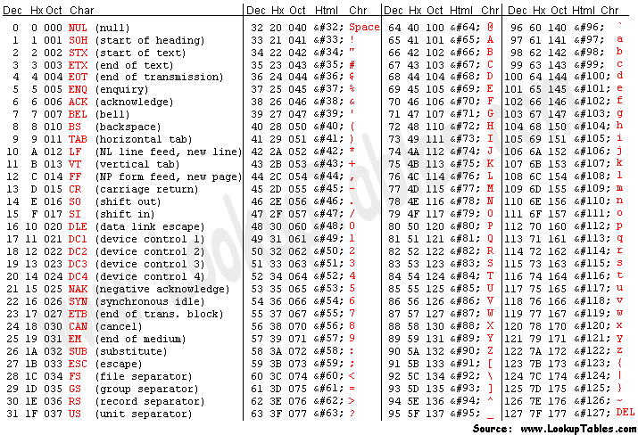
Simple Checksum Hacking Example
= 864
“I hate Tor” → 73 + 32 + 104 + 97 + 116 + 101 + 32 + 84 + 111 + 114
“I love Tom” → 73 + 32 + 108 + 111 + 118 + 101 + 32 + 83 + 97 + 109
= 864
test = "I hate Tor”
csum = 0
for c in test:
print(ord(c))
csum += ord(c)
print(csum)

Slide 5
Cryptographic Integrity → Hash
A hash is cryptographically derived from some data we need to verify the integrity of.
The hash functions cannot be reversed.
An attacker would need to calculate the entire hash and brute force figure out how to change parts of the message.
Examples of Hashes:
SHA-1
SHA-2 (SHA-256)
MD5

Slide 6
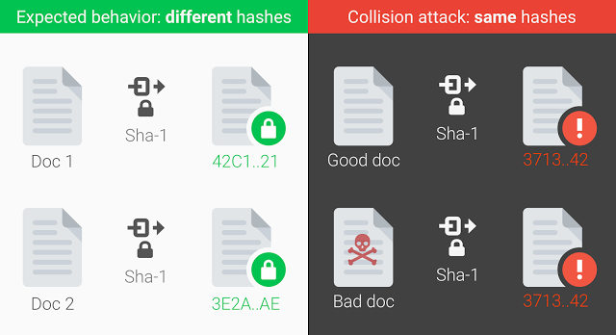
Hash Collision
A “collision” occurs when two data sources produce the same “hash”.
Collisions are always possible, as the hashes are much much smaller than the files (that is the point of them).
i.e., file may be 1 GB, hash is 32-bytes.
A hash makes it computationally infeasible to figure out a hash.

Slide 7
SHA-1 Hash Collision
In 2017 team at CWI Amsterdam + Google performed such a collision attack, using an algorithm much faster than brute force (100000x faster).
SHA-1 (at the time still ‘trusted’) uses 160 bits.
9,223,372,036,854,775,808 SHA1 computations.
6500 years of single-CPU time, or 110 years of Single GPU time.
Google had many many GPUs/CPUs to throw at this…
https://shattered.io/

Slide 8
Authentication + Integrity
Integrity relies on the hash of a file.
A hash is derived from a file, and allows us to send a file over “untrusted” methods.
End user can confirm the hash matches.
But… how can we get that hash to someone?
Why not transfer the entire file using this “secure channel” if we have it?
..answer to that in the next section!

